Slide 1
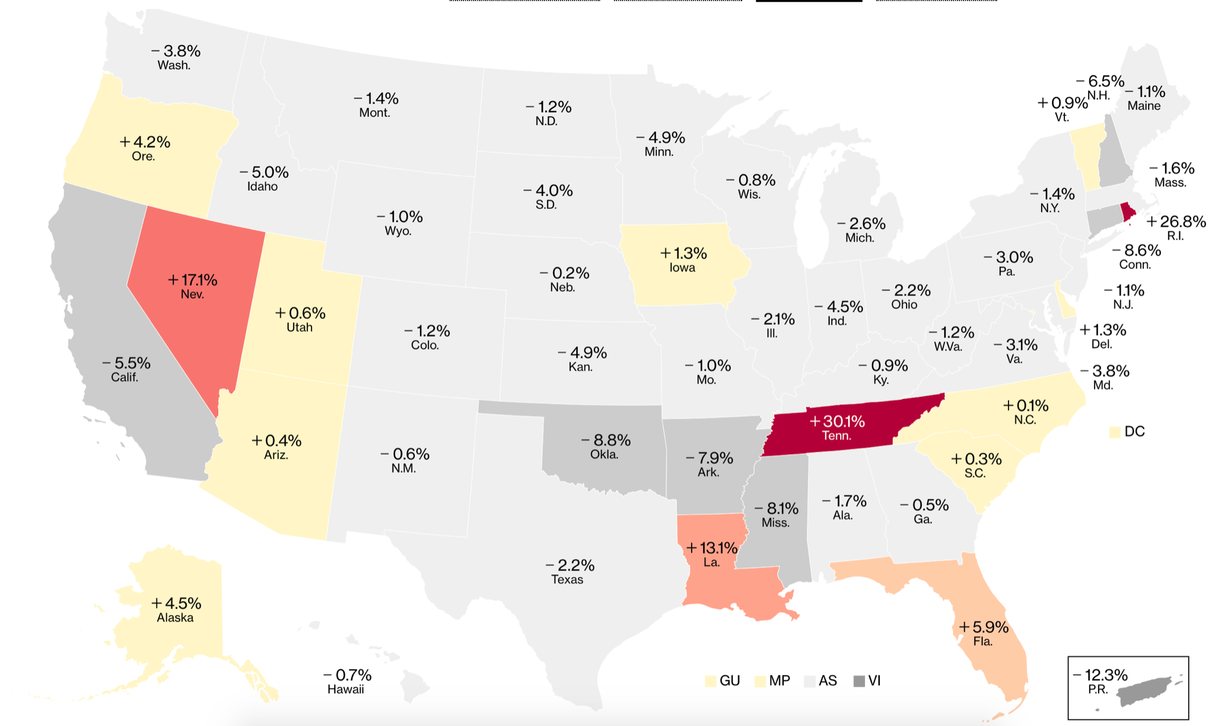
Present by: Yihang Zhao; Runzhe Tang; Yuwen Luo
U.S Covid-19 Data Mining Analysis

Slide 2
Content
3.1 Linear
3.1.1 Feature Selection
3.1.2 Model Fitting
3.1.3 Finding the most important variables
3.2 Classification
3.2.1 Data Preperation
3.2.2 Features Selection & Model Fitting
3.2.3 Model Accuray Comparison
Introduction
Problem of Interest
Process of Data Mining
Conclusion

Slide 3
Introduction
Data Source: The Covid Tracking Project (https://covidtracking.com/data)
The original data: national-history.csv
originally data: 17 variables ( 15 variables which we are using)
Split the data set into Training set and Test set
Then, working on the training set

Slide 4
2. Problem of Interest
Which variables are most important in predicting the dependent variable (death Increase/ death Direction)?
death Increase (Linear Regression)
Dependent Varibale
death Direction (Classification)

Slide 5
Dataset Description
Two Predictors: deathincrease ; death direction
date (YYYY/MM/DD)
death
states(name of state in the United States)
hospitalized cases (Currently, Increase,Cumulative)
In ICU (Cumulative, Currently)
Negative
Negative (Increased cases)
Ventilator (Currently, Cumulative)
Positive
PositiveIncrease
TotalTestResults
TotalTestResultsIncreas

Slide 6
Potential Challenge & Solution
Many variable columns have empty values at the start of Covid-19, our plan is to set these values as 0.
Some variables have large values and some have small values, so we standardize the dataset at the beginning.
Variable ‘date’ is not helping in predicting the dependent variable and variable ‘death’ is highly correlated with the dependent variable. So, we delete both of them.

Slide 7
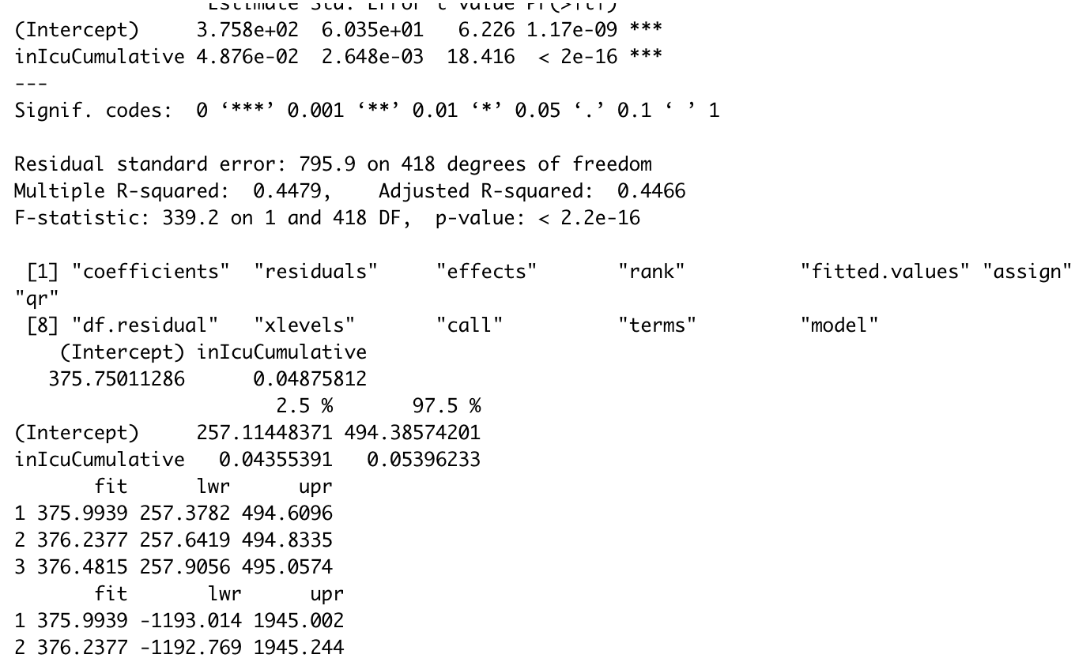
Simple Linear Regression
Create the simple Linear Regression and plot the raw data
with regression line

Slide 8
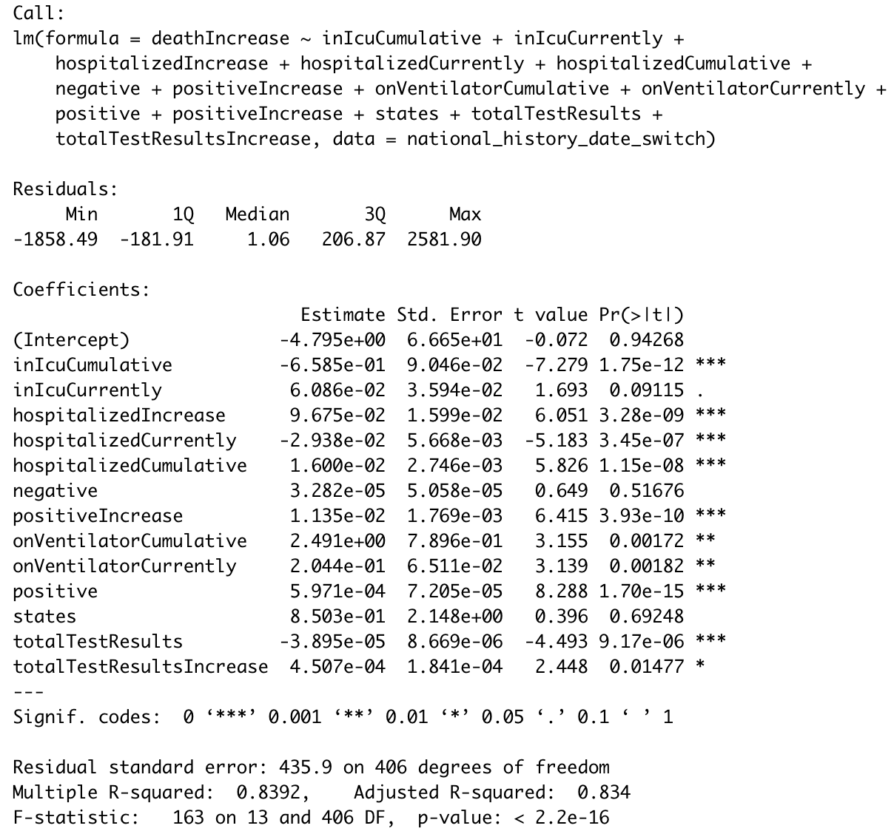
Multiple Linear Regression
Run regression of deathIncrease on all variables

Slide 9
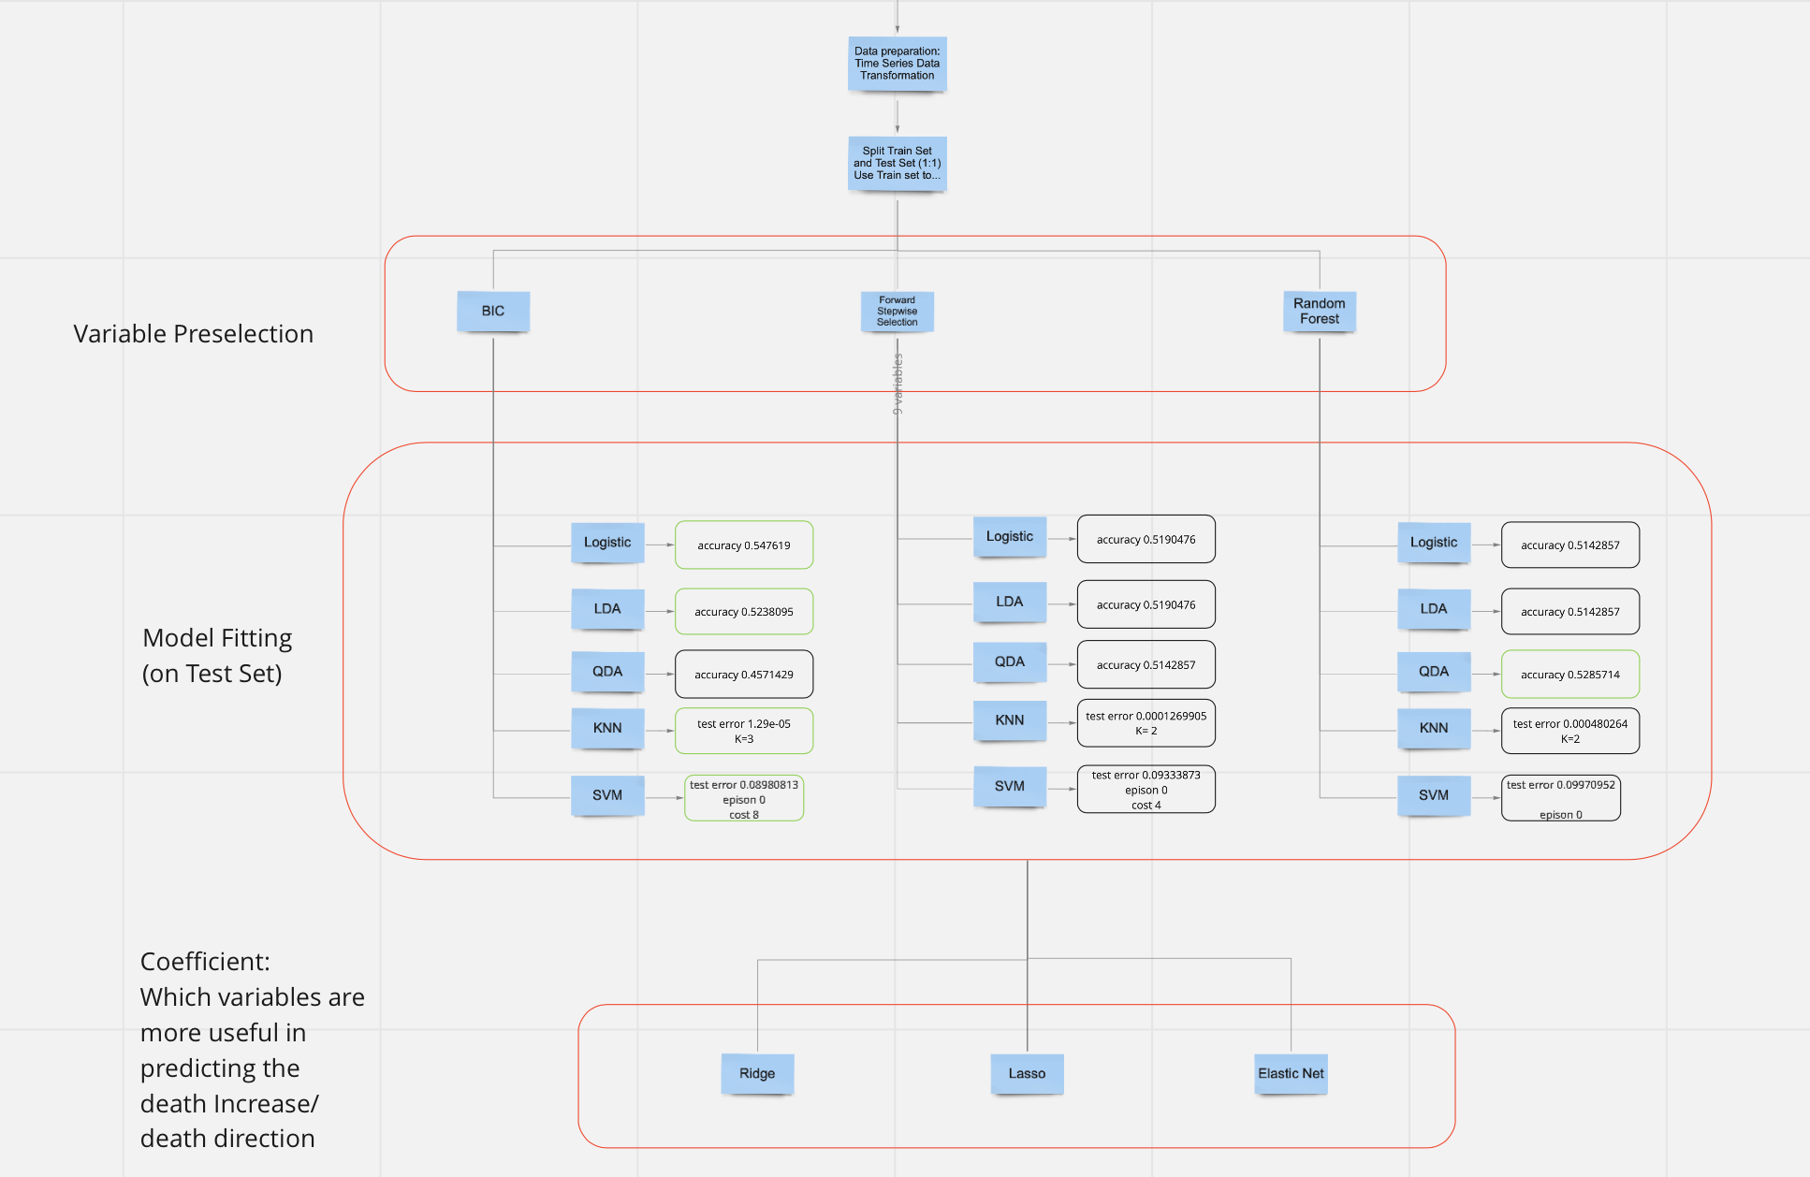
Road
Map

Slide 10
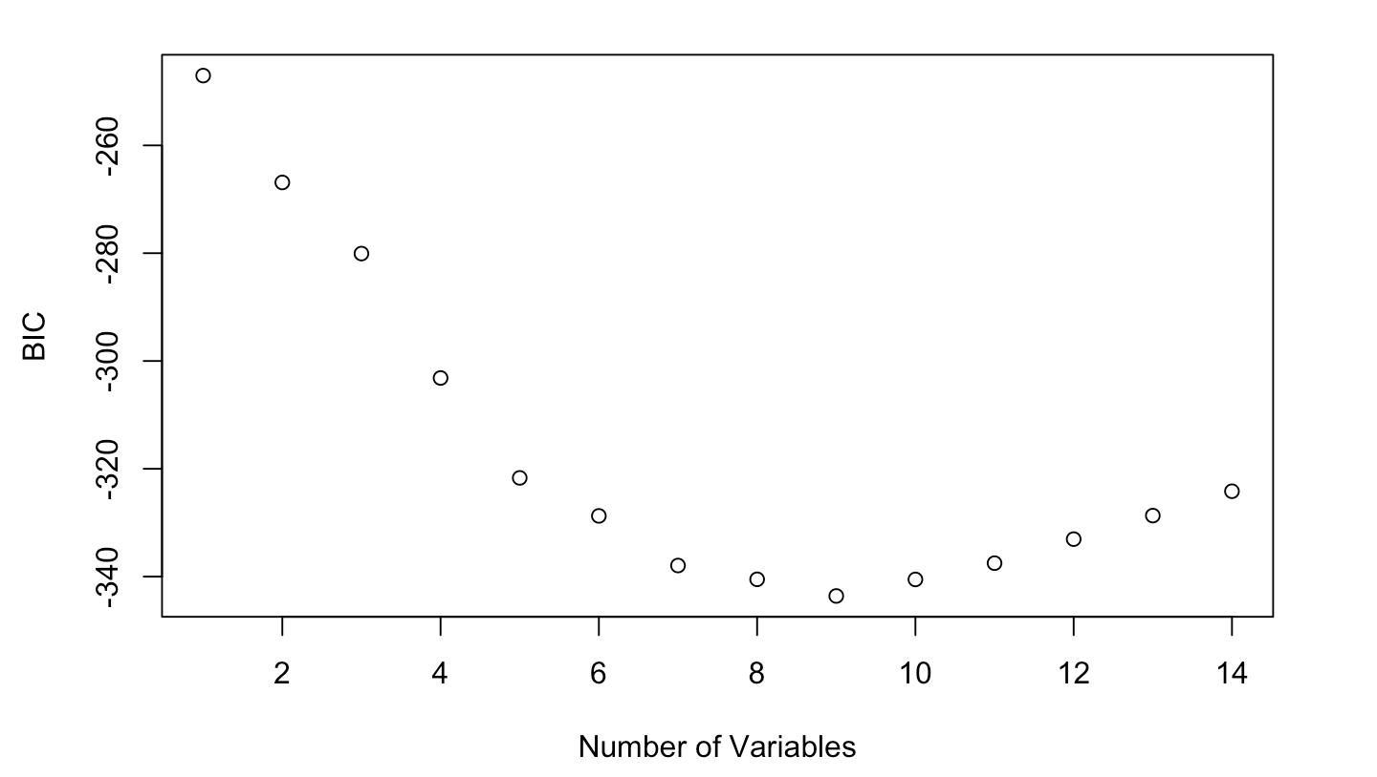
3.1.1 Feature selection (BIC)
Based on the pre-selection approach BIC,
the best model contains 9 independent variables, which include inIcuCumulative, hospitalizedCurrently, onVentilatorCurrently, positive, totalTestResults...

Slide 11
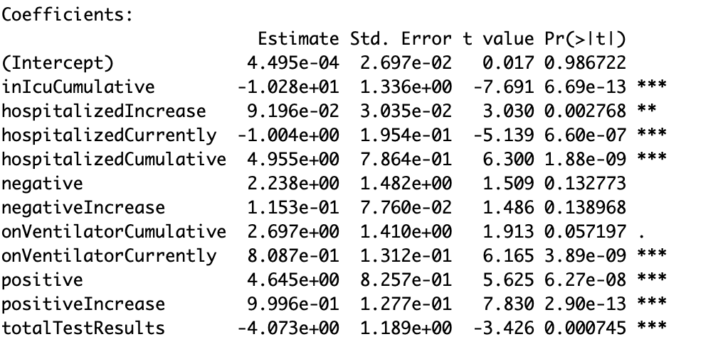
3.1.1 Feature selection (Stepwise)
Based on the Stepwise approach, we find the model which contains 8 variables

Slide 12
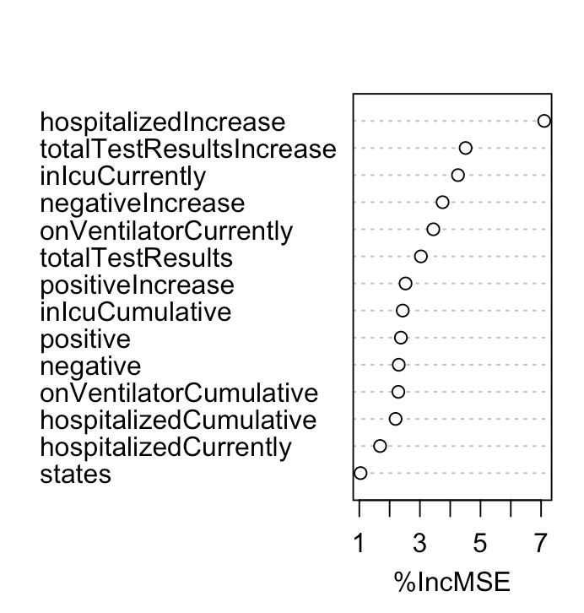
3.1.1 Feature selection (Random Forest)
Because this is a linear model, we use the metrics %IncMSE to pick the variables we want. We use variable ‘totalTestResults’ and above 6 variables as our independent variables.
Notes:
linear -- p/3 = 5 -- mtry=5

Slide 13
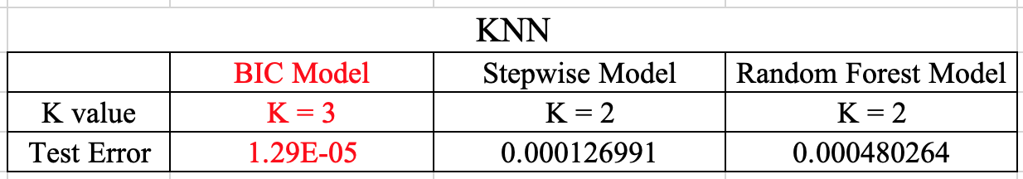
3.1.2 Model Fitting (KNN)
Based on the K Nearest Neighbor Classifier, BIC Model has the lowest test error with K = 3

Slide 14
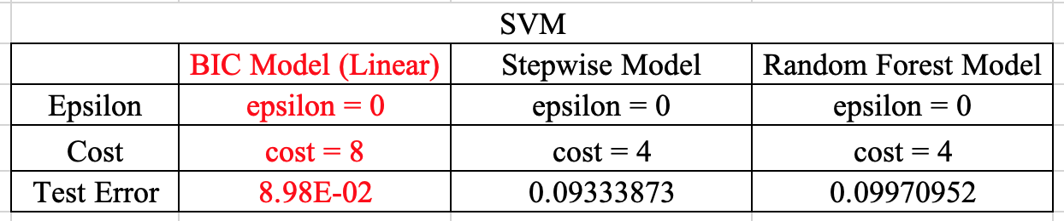
3.1.2 Model Fitting (SVM)
Based on Support Vector Machines technique, we found BIC model with epsilon = 0 and cost = 8 has the lowest error.

Slide 15
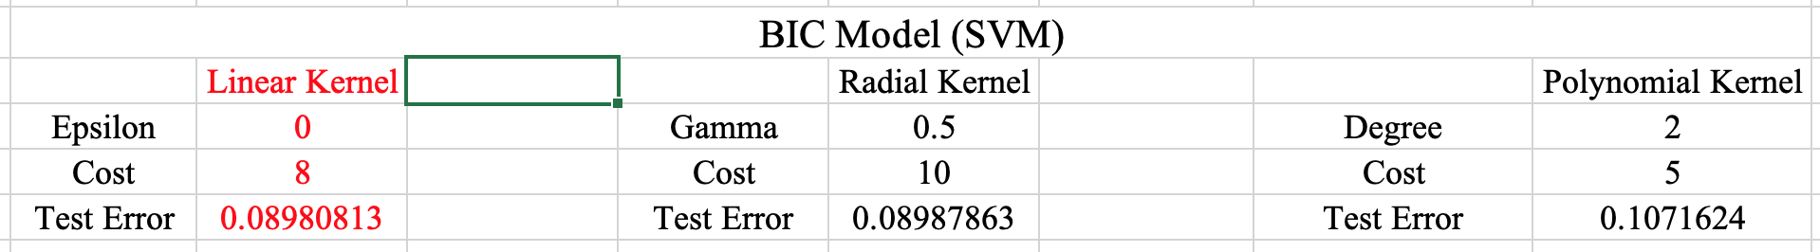
3.1.2 Model Fitting (SVM -- Kernel)
Then, we fitted BIC Model with 3 SVM models and found the linear kernel has the lowest test error.

Slide 16
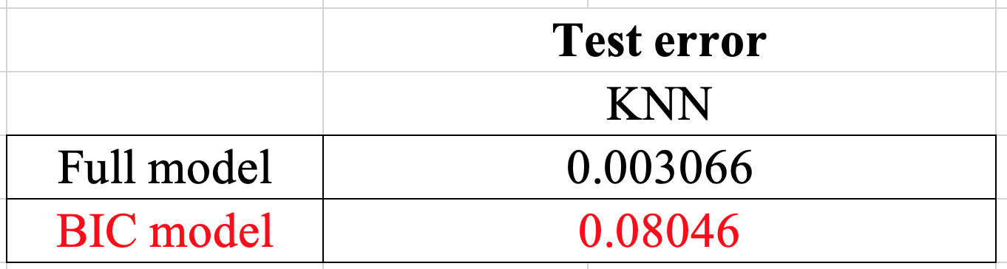
3.1.2 Model Fitting

Slide 17
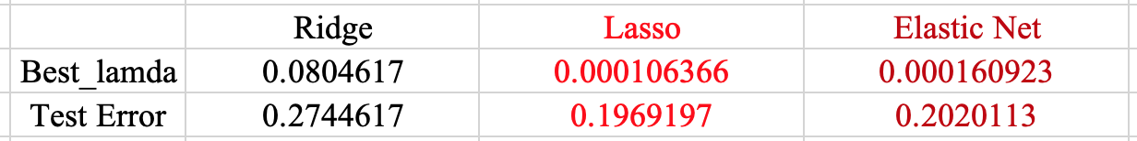
3.1.3 Finding most important variables
We use 3 methods: Ridge, Lasso and Elastic Net to find the coefficients of variables within the BIC model.
Notes:
The next step is to find the most independent variables within the BIC model

Slide 18
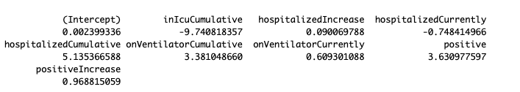
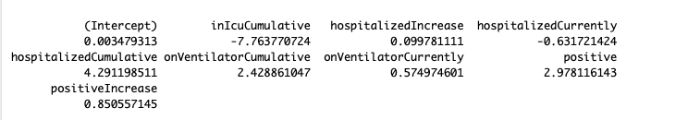
3.1.3 Finding most important variables
Lasso and Elastic Net give similar results which indicate variables
‘inIcuCumulative’,‘hospitalizedCumulative’, ‘onVentilatorCumulative’ and ‘positive’ are the most important varibles in predicting ‘deathincrease’.
Lasso
Elastic Net

Slide 19
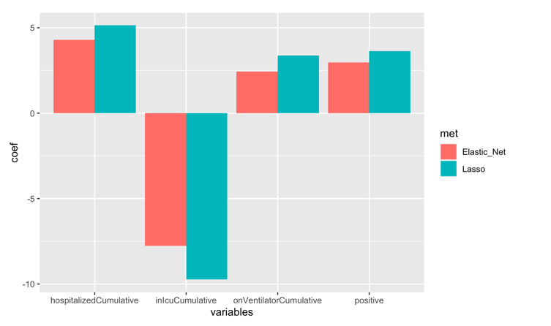
3.1.3 Finding most important variables

Slide 20
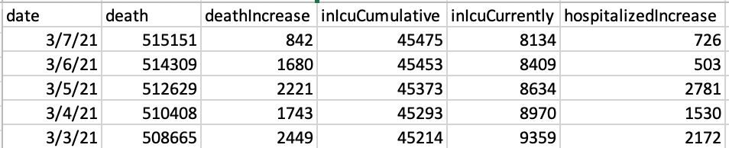
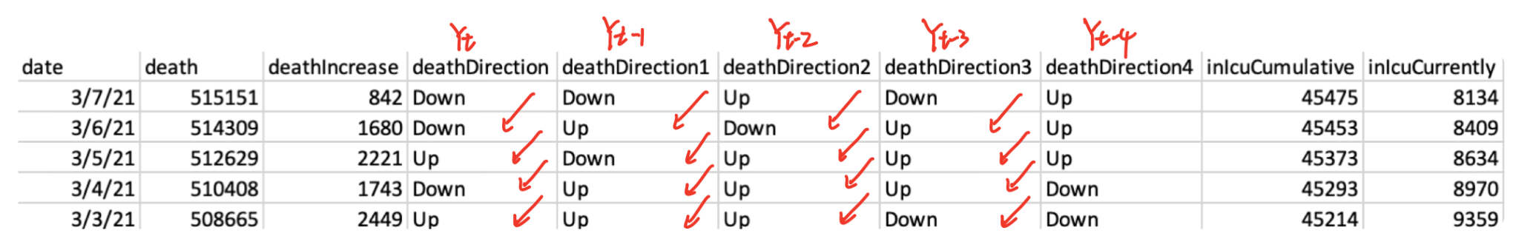
3.2.1 Data Preparation
Origin Dataset
Time Series Dataset

Slide 21
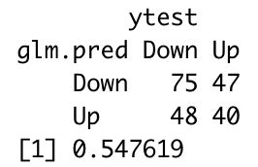
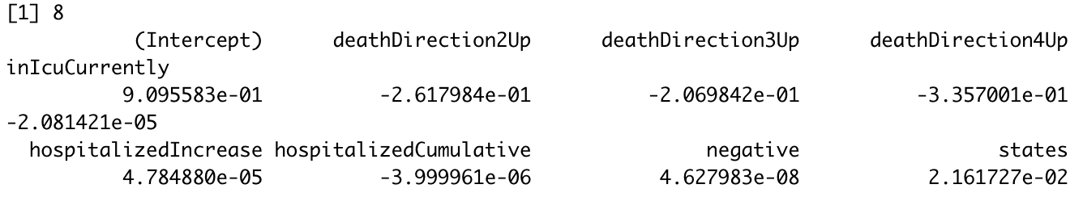
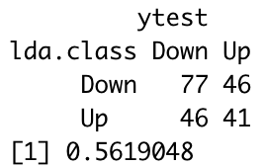
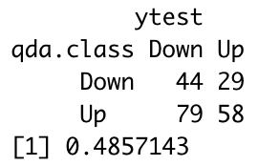
3.2.2 Feature Selection & Model Fitting
Logistic
Classification - BIC
LDA
QDA

Slide 22
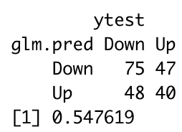
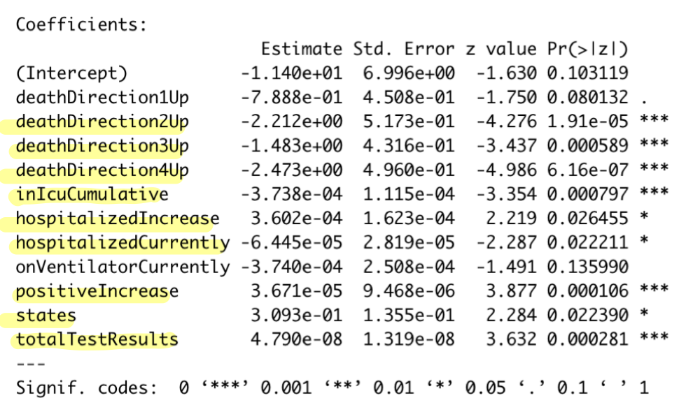
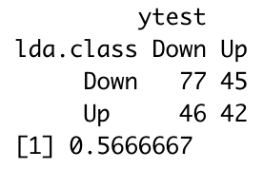
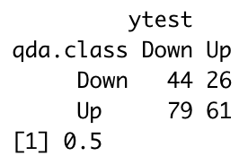
3.2.2 Feature Selection & Model Fitting
Classification - Stepwise
Logistic
LDA
QDA

Slide 23
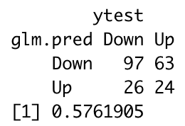
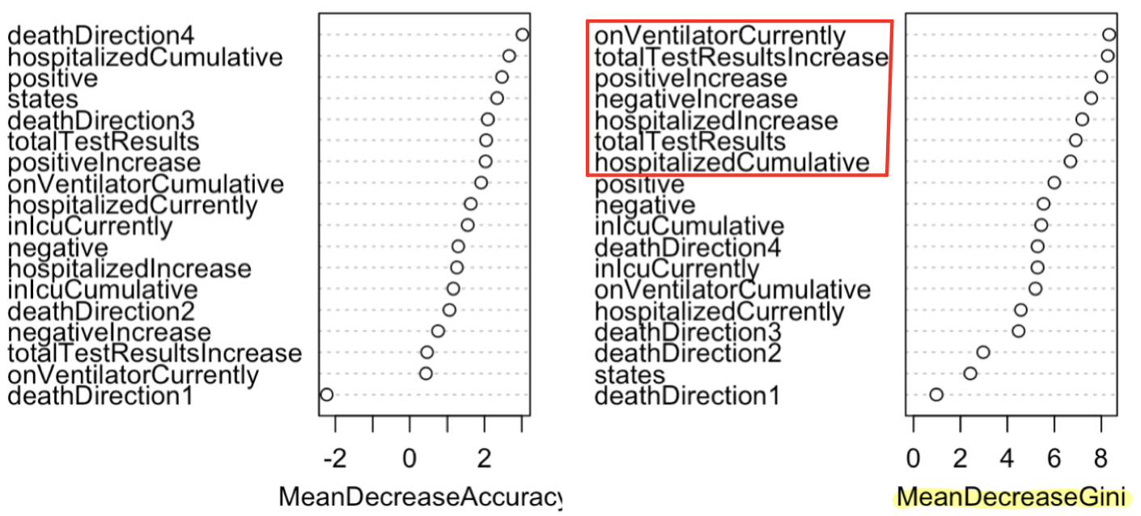
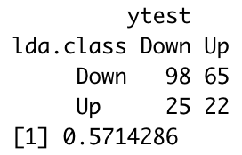
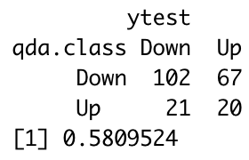
3.2.2 Feature Selection & Model Fitting
Classification - Random Forest
Logistic
LDA
QDA

Slide 24
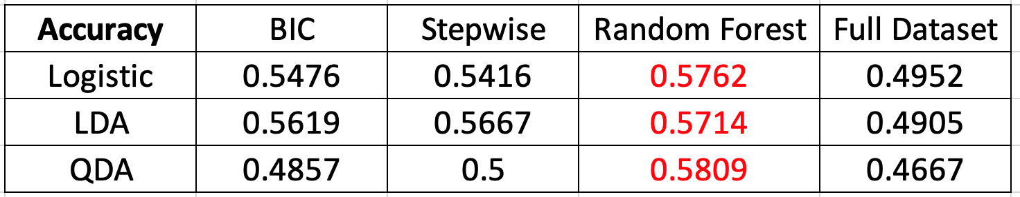
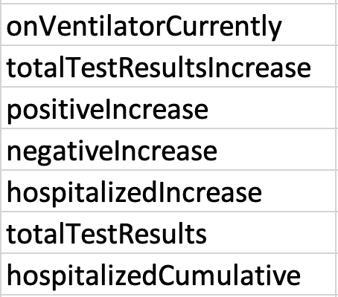
3.2.3 Model Accuray Comparison
Model Accuracy Comparison
Variables Selected

Slide 25
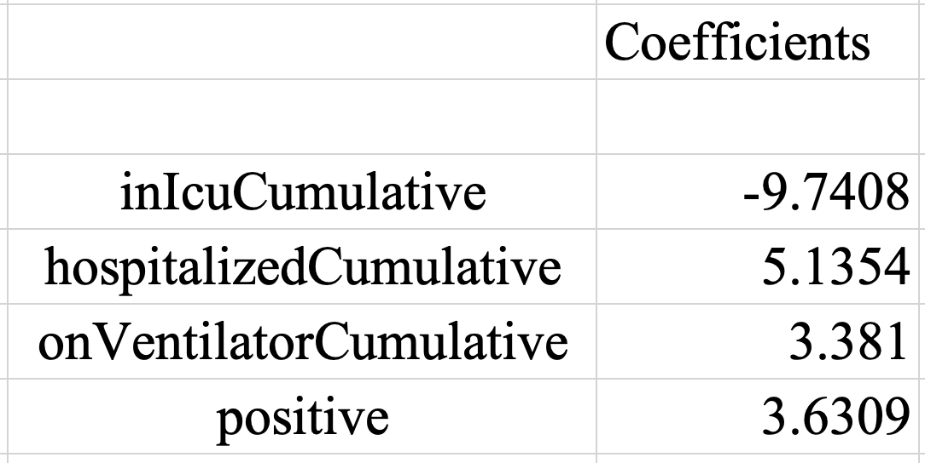
4. Conclusion:Respond to Problem of Interest
Which variables are most important in predicting the dependent variable (death Increase/ death Direction)?
Variable Seleted by Classification
deathDirection ~
Variable Seleted by Linear Regression
deathIncrease ~

Slide 26
Q&A

